Slide 1
Software modeling
Online Flight Tracking System

Slide 2
Introduction
The travelers of flights don’t have exact information about the flight timing,
therefore, you are required to design and implement a system using which the users
through computer or smartphone get the information about flight timings and if the
flight is on time and not. Also the system should allow the users to web-check in if
the user has no check in luggage and only hand carry. The flights live information
can be procured form more than 2 sources viz., the airport authority server and
online free sources such as adware flight, to ensure the accuracy of the information
based on which users can plan their travel.

Slide 3
Scope
The software product to be developed is the Online Flight Tracking System
(OFTS), the airline tracking website is an application stored in the Airport
Authority server. The purpose of the website is to resolve the client to allow
website users to perform tasks related to booking airline flight. users are only
allowed to search for available flights. Member users have the right to search for
available flights, Admin can create a plan and delete a flight and to edit their
member information. Admin is required to login in to their account prior to flight
booking.

Slide 4
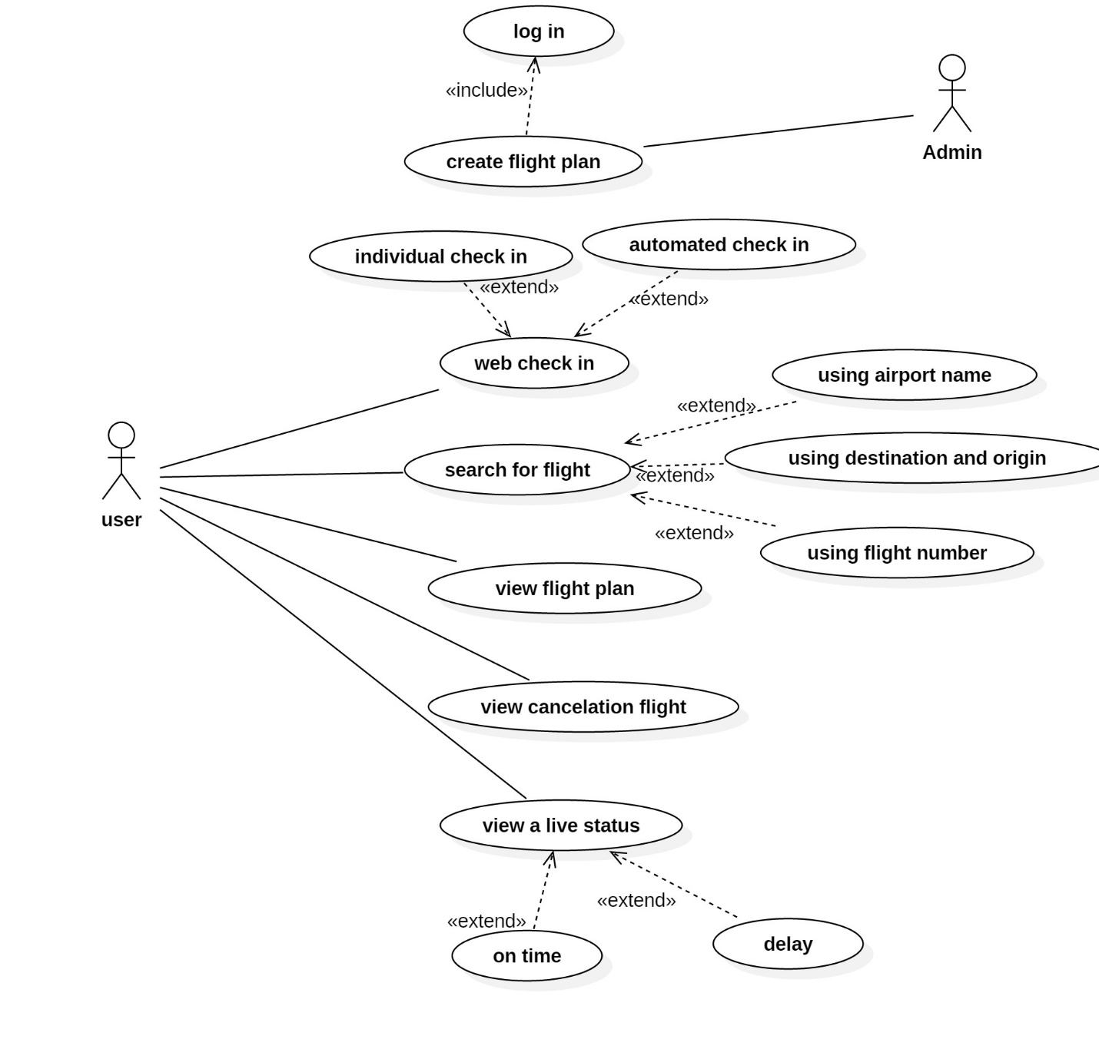
Use Case Diagram:

Slide 5
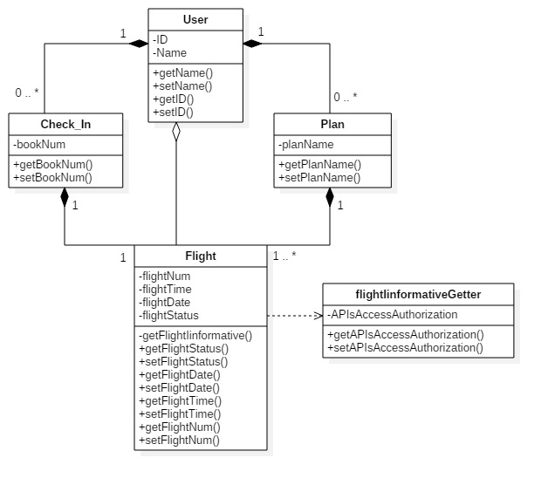
Class Diagram:

Slide 6
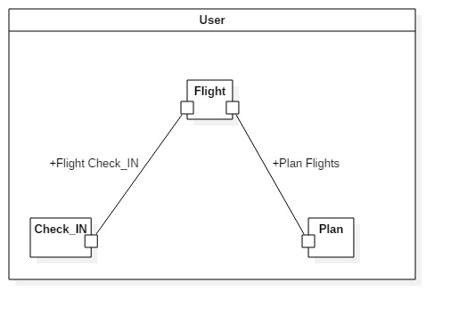
Composite Diagram :

Slide 7
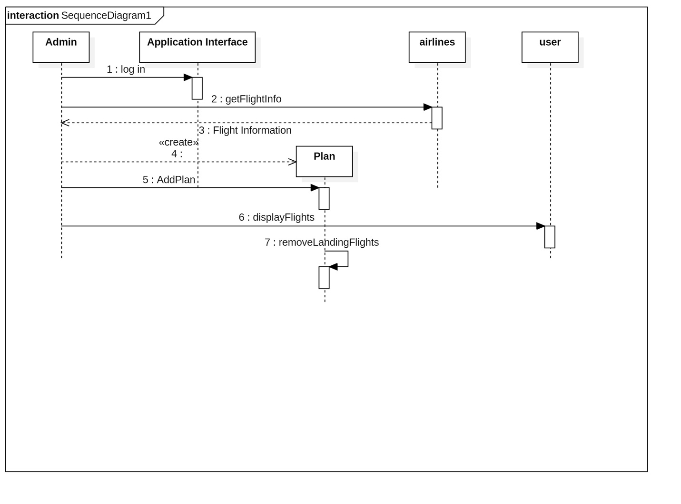
Sequence Diagram:

Slide 8
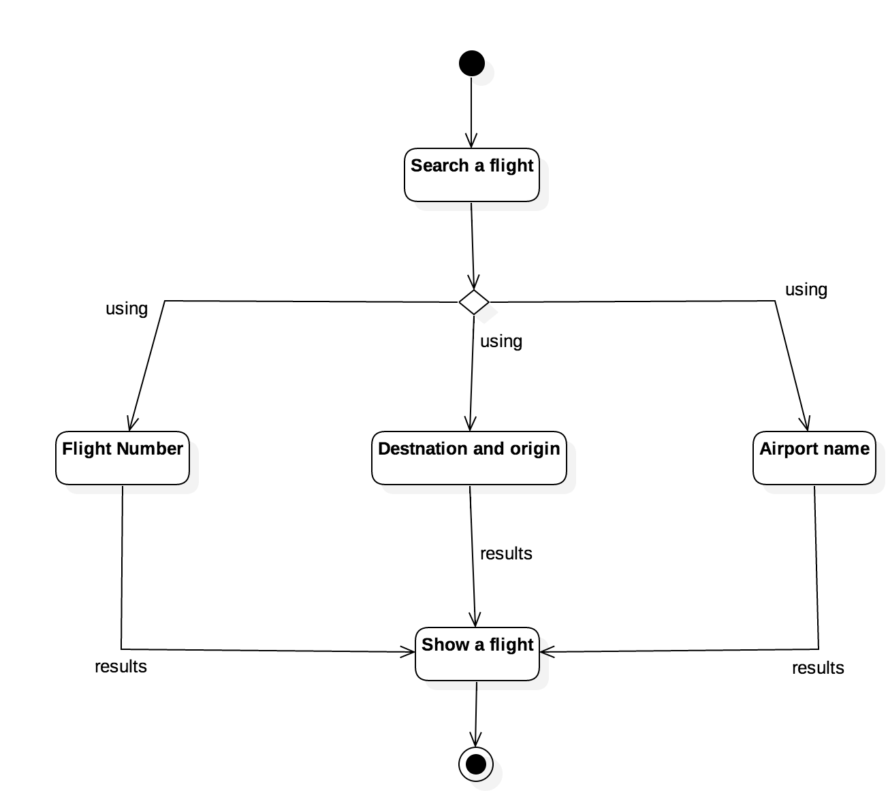
State Diagram :

Slide 9
Java Code Transformation:

Slide 10
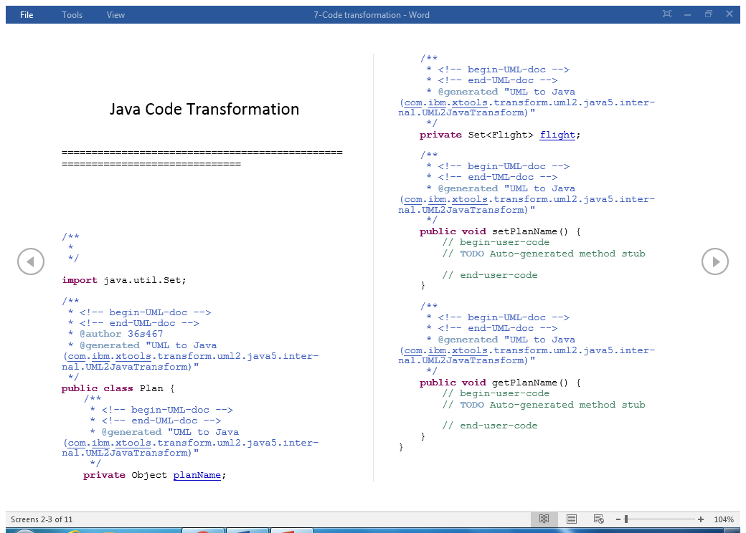
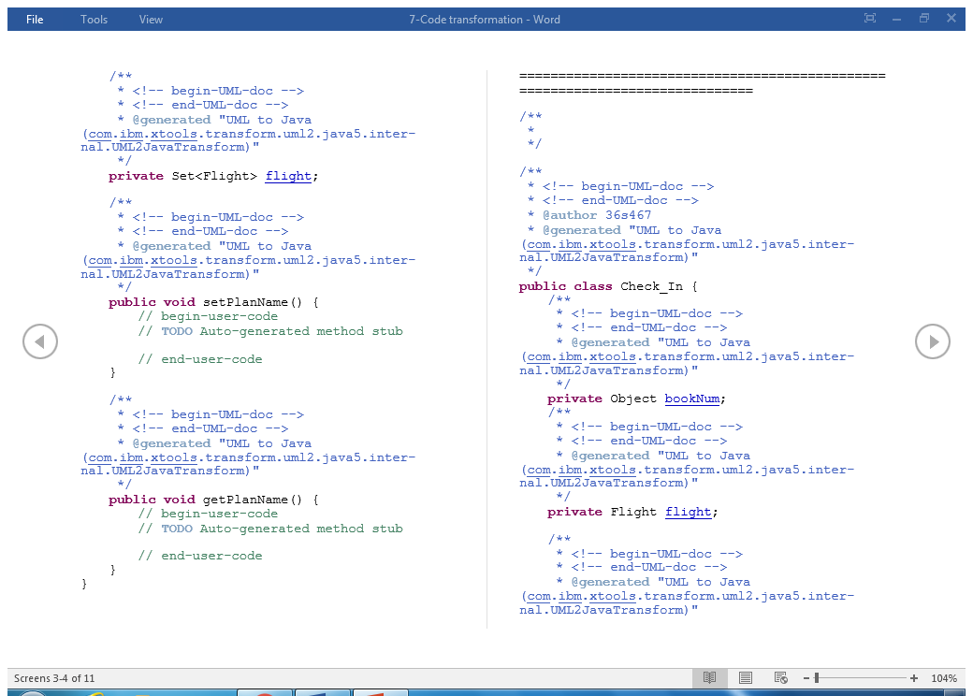

Slide 11
Abdulrhman Ali Alsenedi Abdulmajeed Saleh Alaskar Khalid Abdulhadi Alqahtani Asim Mohammed Alali
Thank you ☺

